Slide 1
CoffeeScript, Linguistics and Cockney Rhyming Slang
Brandon Satrom
@BrandonSatrom
UserInExperience.com

Slide 2
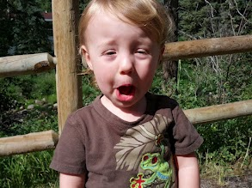
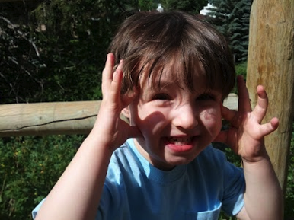
Me, in Three Slides
Husband and Father
Program Manager for Kendo UI
Austin, TX
www.userinexperience.com
@BrandonSatrom
github.com/bsatrom

Slide 3

#html5tx
02.02.13
HTML5tx.com
@HTML5tx

Slide 4
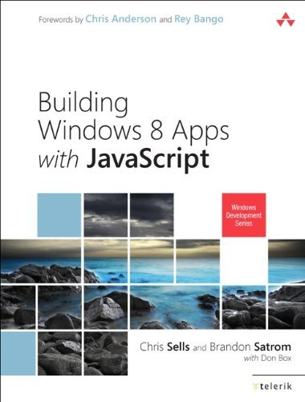
My Book
http://bit.ly/Win8Book

Slide 5


CoffeeScript? RLY?

Slide 6

Notes:
\

Slide 7
pre- + processor
“…a program that processes its input data to produce output that is used as input to another program.” (Source: Wikipedia)
When applied to the web, the term usually means a language that can be combined with a transpiler to output a canonical “web language,” like JavaScript or CSS.

Slide 8

Web Development is Changing
CC image copyright Miguel Angel Sune, used with Permission - http://www.flickr.com/photos/miguel9120_fotos/6762014771/

Slide 9
PreProcessors, The Web and You
(aka, Brandon’s Golden Rules for Pre-Processor Adoption)

Slide 10
#1 - Use a preprocessor before forming an opinion about it
"The challenge with new programming tools is that, unlike conventional tools, we don't know what they're good for without a lot of experimentation." – iamnoah (https://gist.github.com/3200682)

Slide 11
#2 – If a Preprocessor Helps you Do your Job Better, Use it.
… and if not, don’t.

Slide 12


VS.

Slide 13
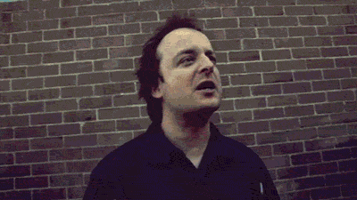
A JavaScript Dialectic

Slide 14


Don’t Be A JavaScriptster
I loved JavaScript before it was cool
Of course, I also hated it back when everyone else did too…

Slide 15
What?
What is CoffeeScript?

Slide 16
“It’s Just JavaScript”
Or “Unfancy JavaScript”

Slide 17
“A little language”

Slide 18
More A Dialect, Less A Language
Color === Colour
function(foo) {} === (foo) ->

Slide 19
Subtle Linguistics
Dave has two children. His youngest is in Reception, and his favourite colour is green. His oldest is Year 4, and loves to ride the lift outside his flat.
Dave has two children. His youngest is in Pre-K, and his favorite color is green. His oldest is in 3rd Grade, and he loves to ride the elevator outside his apartment.

Slide 20
Not so subtle linguistics…
Sentence | Extended Phrase | Rhymes With
I’ve got a sore billy. | Billy Goat | Throat
That’s a nasty old boris you’ve got there son. | Boris Karloff | Cough
Ere, you’ve got your brass wrong! | Brass Tacks | Facts
‘ow about a Brittney? | Brittney Spears | Beers
We’re all in Barney! | Barney Rubble | Trouble
Think he’s been smoking a bit of Bob | Bob Hope | (you get the idea)

Slide 21
CoffeeScript is not a replacement for Learning JavaScript

Slide 22
Compiles 1:1 to JavaScript
1:1 being Concept to Concept

Slide 23
Conceptual Equivalence
CoffeeScript
JavaScript
numbers = [1..10]
printNum = (number) ->
console.log "This is number #{number}"
printNum for num in numbers
var num, numbers, printNum, _i, _len;
numbers = [1, 2, 3, 4, 5, 6, 7, 8, 9, 10];
printNum = function(number) {
return console.log("This is number " + number);
};
for (_i = 0, _len = numbers.length; _i < _len; _i++) {
num = numbers[_i];
printNum;
}

Slide 24
Conceptual Equivalence
CoffeeScript
JavaScript
numbers = [1..10]
printNum = (number) ->
console.log "This is number #{number}"
printNum num for num in numbers
var num, numbers, printNum, _i, _len;
numbers = [1, 2, 3, 4, 5, 6, 7, 8, 9, 10];
printNum = function(number) {
return console.log("This is number " + number);
};
for (_i = 0, _len = numbers.length; _i < _len; _i++) {
num = numbers[_i];
printNum(num);
}

Slide 25
Conceptual Equivalence
CoffeeScript
JavaScript
numbers = [1..10]
printNum = (number) ->
console.log "This is number #{number}"
printNum num for num in numbers
var num, numbers, printNum, _i, _len;
numbers = [1, 2, 3, 4, 5, 6, 7, 8, 9, 10];
printNum = function(number) {
return console.log("This is number " + number);
};
for (_i = 0, _len = numbers.length; _i < _len; _i++) {
num = numbers[_i];
printNum(num);
}

Slide 26
Conceptual Equivalence
CoffeeScript
JavaScript
numbers = [1..10]
printNum = (number) ->
console.log "This is number #{number}"
printNum num for num in numbers
var num, numbers, printNum, _i, _len;
numbers = [1, 2, 3, 4, 5, 6, 7, 8, 9, 10];
printNum = function(number) {
return console.log("This is number " + number);
};
for (_i = 0, _len = numbers.length; _i < _len; _i++) {
num = numbers[_i];
printNum(num);
}

Slide 27
Where?
Where do I get it?

Slide 28
Ways to Get CoffeeScript
node.js & npm
Script Tags
<script type=“text/coffeescript”></script>
<script src=“coffee-script.js”></script>
Rails 3.1+
SassAndCoffee (.NET)
CoffeeScript Packages
$ npm install –g coffee-script

Slide 29
How?
How can I use and learn it?

Slide 30
REPL
$ coffee
coffee> [1..10]

Slide 31
COMPILE
$ coffee –o js/ -cw lib/

Slide 32
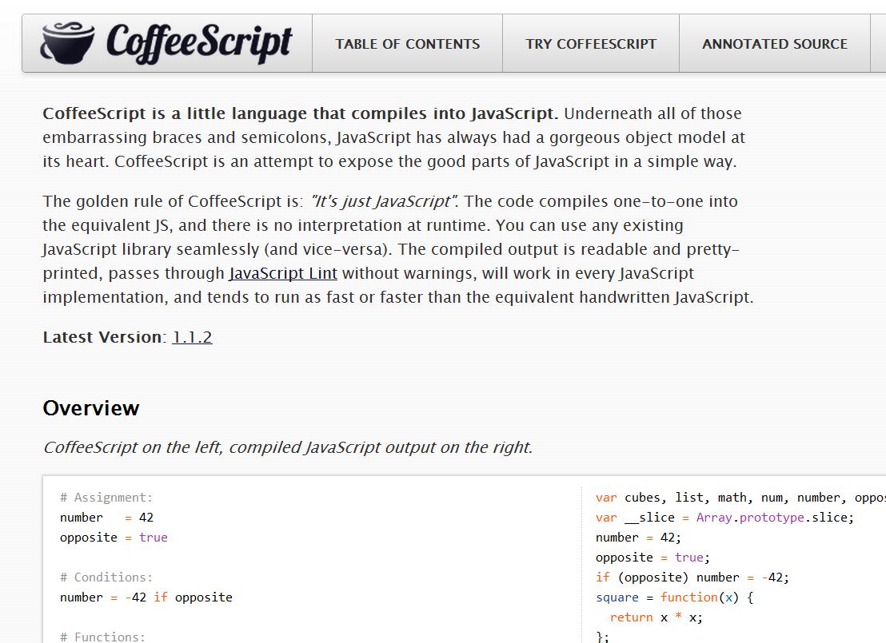
CoffeeScript Basics

Slide 33
Assignment
name = “Brandon”
married = yes
children = 2
var children, married, name;
name = "Brandon";
married = true;
children = 2;

Slide 34
Functions
square = (x) -> x * x
printInfo = (name, numChildren) ->
“Hi #{name}, I see you have #{numChildren} children.”
var printInfo, square;
square = function(x) {
return x * x;
};
printInfo = function(name, numChildren) {
return "Hi " + name + ", I see you have " + numChildren + " children";
};

Slide 35
Strings
num = 99
“I’ve got #{num} problems, and JavaScript ain’t one.”
city = "Brooklyn"
"No. Sleep. 'Till. #{city}"
var city, num;
num = 99;
"I've got " + num + " problems, but JavaScript ain't one";
city = "Brooklyn";
"No. Sleep. 'Till. " + city;

Slide 36
Objects
kids =
bigBrother:
name: “Benjamin”
age: 2
littleBrother:
name: “Jack”
age: 1
var kids;
kids = {
bigBrother: {
name: “Benjamin”,
age: 2
},
littleBrother: {
name: “Jack”,
age: 1
}
};

Slide 37
Lexical Scoping
outer = 42
findMeaning = ->
inner = 43
outer
inner = findMeaning()
var findMeaning, inner, outer;
outer = 42;
findMeaning = function() {
var inner;
inner = 43;
return outer;
};
inner = findMeaning();

Slide 38
Lexical Scoping 2
notGlobal = "Hello"
global = "Goodbye"
window.global = global
(function() {
var global, notGlobal;
notGlobal = "Hello";
global = "Goodbye";
window.global = global;
}).call(this);

Slide 39
Everything, an Expression
grade = (student) ->
if student.excellentWork
"A+"
else if student.okayStuff
if student.triedHard then "B" else "B-"
else
"C"
eldest = if 24 > 21 then "Liz" else "Ike"
var eldest, grade;
grade = function(student) {
if (student.excellentWork) {
return "A+";
} else if (student.okayStuff) {
if (student.triedHard) {
return "B";
} else {
return "B-";
}
} else {
return "C";
}
};
eldest = 24 > 21 ? "Liz" : "Ike";

Slide 40
Conditionals
mood = greatlyImproved if singing
if happy and knowsIt
clapsHands()
chaChaCha()
else
showIt()
lunch = if friday then water else redBull
options or= defaults
var lunch, mood;
if (singing) {
mood = greatlyImproved;
}
if (happy && knowsIt) {
clapsHands();
chaChaCha();
} else {
showIt();
}
lunch = friday ? water : redBull;
Options || (options = defaults);

Slide 41
Operators and Aliases
CoffeeScript | JavaScript
is, == | ===
isnt, != | !==
not | !
and | &&
or | ||
true, yes, on | true
false, no, off | false
@, this | this
of | in
in | no equivalent

Slide 42
Why?
Why use CoffeeScript?

Slide 43
#1 – Some Pros and Cons
Why?

Slide 44
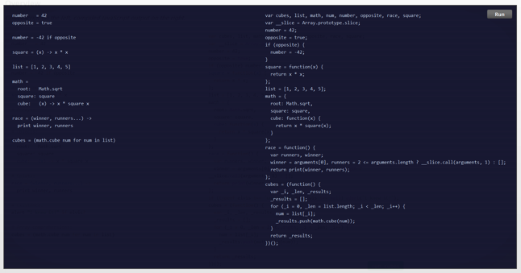
Pro
More succinct code

Slide 45
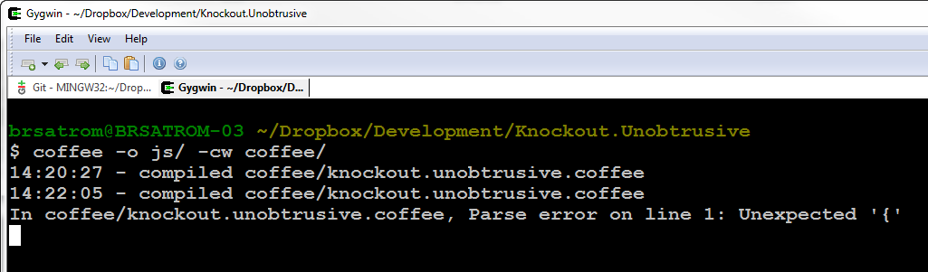
Con
Extra compile step between you and the “real” code

Slide 46
Pro
hi == bye
global = "everywhere?"
switch day
when "Fri", "Sat"
if day is bingoDay
go bingo
go dancing
when "Sun" then go church
else go work
(function() {
var global;
hi === bye;
global = "everywhere?";
switch (day) {
case "Fri":
case "Sat":
if (day === bingoDay) {
go(bingo);
go(dancing);
}
break;
case "Sun":
go(church);
break;
default:
go(work);
}
})();
Avoid Snake Pits & Get JS Patterns for Free

Slide 47
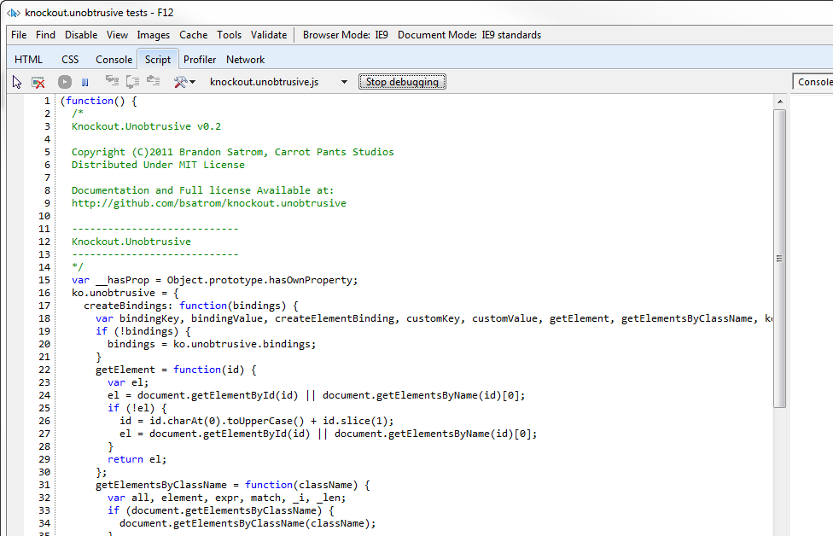
Con
Errors and Debugging: it’s still JavaScript in there

Slide 48
Pro
Conjecture!
As fast or faster JavaScript

Slide 49
Con
Code Generation(?)!
Dare I say it? Code Generation!

Slide 50
#2 - Improve Your JavaScript
Why?

Slide 51
The Five Stages of JavaScript
Avoidance
Concession
Abstraction
Failure
Enlightenment

Slide 52
arr = new Array(4, 8, 15, 16);
arr[4] = 23;
arr[5] = 42;
for (i = 0; i < arr.length; i++)
{
enterLottoNum(arr[i]);
}

Slide 53
var arr = [4, 8, 15, 16, 23, 42];
for (var i = 0; i < arr.length; i++) {
enterLottoNum(arr[i]);
}

Slide 54
var arr, num, _i, _len;
arr = [4, 8, 15, 16, 23, 42];
for (_i = 0, _len = arr.length;
_i < _len; _i++) {
num = arr[_i];
enterLottoNum(num);
}

Slide 55
CoffeeScript made me want to be
a better man
JavaScript
Programmer

Slide 56
#3 – Adoption, By Degree
Why?

Slide 57
CoffeeScript is not an all-or-nothing choice

Slide 58
Consider using CoffeeScript…
As a JavaScript training tool
For your server-side code in a Node.js App
Or…

Slide 59
Using CoffeeScript for Testing…
describe 'Math:', ->
describe 'fib()', ->
it 'should calculate numbers up to fib(16)', ->
fib = [0, 1, 1, 2, 3, 5, 8, 13, 21,
34, 55, 89, 144, 233, 377, 610, 987]
expect(Math.fib(i)).toEqual fib[i] for i in [0..16]

Slide 60
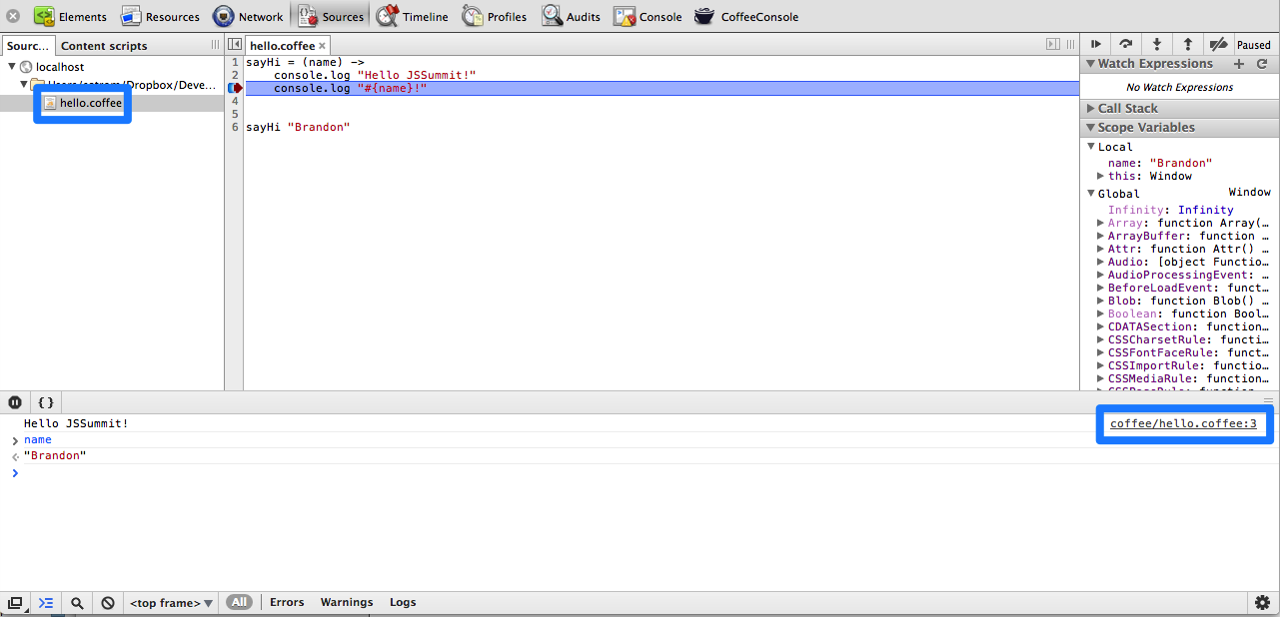
Source Maps*!
*Currently requires using CoffeeScriptRedux
(github.com/michaelficarra/CoffeeScriptRedux/)

Slide 61
#4 - Influencing JS.Next
Why?

Slide 62
function f(a = 0, b = a*a) {
return [a, b];
}
function f(a, b, ...others) {
return others.concat(a, b);
}
for (var v of [1, 2, 3]) print(v)

Slide 63
class SkinnedMesh extends THREE.Mesh {
constructor(geometry, materials) {
super(geometry, materials);
this.identityMatrix = new THREE.Matrix4();
this.bones = [];
this.boneMatrices = [];
...
}
update(camera) {
...
super.update();
}
}

Slide 64
module EventAggregator {
export function sub() { /* … */ }
export function pub() { /* … */ }
}
import {sub, pub} from EventAggregator;
import $ from
“http://code.jquery.com/jquery-1.8.2.min.js”;

Slide 65
JavaScript Gets Better
JavaScript
jQuery, et al.
ECMAScript 5
CoffeeScript
ECMAScript 6
JS.Next
(and beyond)

Slide 66
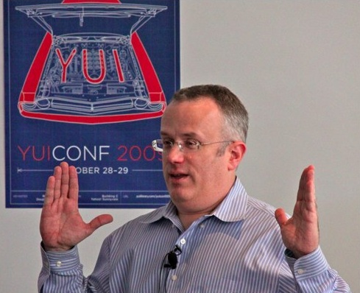
CoffeeScript Is not a replacement for JavaScript
"We are not just advocating a language on top of JS that you use to avoid JS (GWT, Haxe, Objective-J, etc.). We are advocating that you all help build a better JS on JS, which then becomes standardized as JS.next."
- Brendan Eich

Slide 67
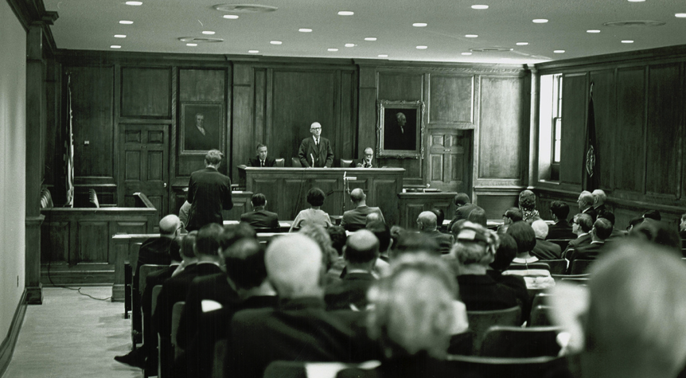
The People vs. The WHATWG, TC39 and the W3C
CC image copyright William & Mary Law Library, used with Permission - http://www.flickr.com/photos/wolflawlibrary/5051047245/

Slide 68
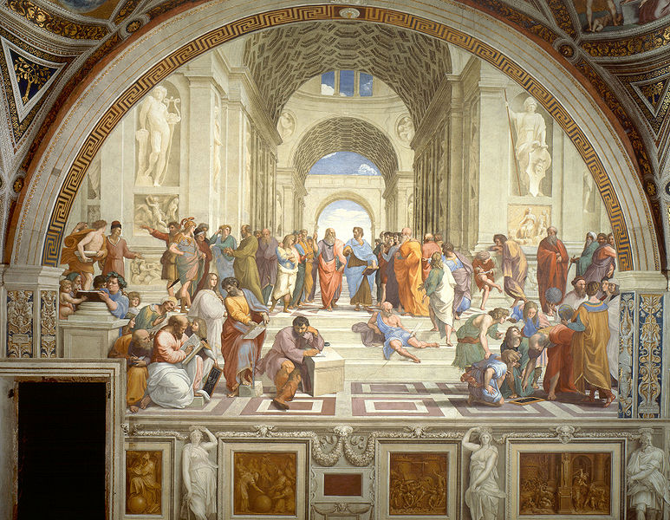
the JavaScript Dialectic, Revisited
What Can I/We/Everyone Learn from CoffeeScript?

Slide 69
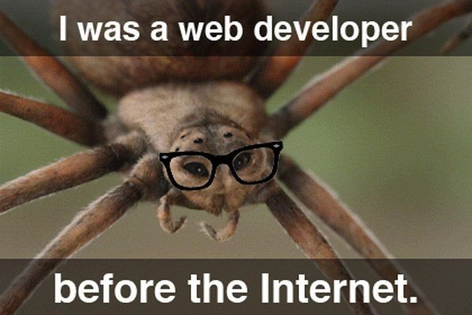
Questions?
@BrandonSatrom
brandon@kendoui.com
UserInExperience.com

